Slide 1
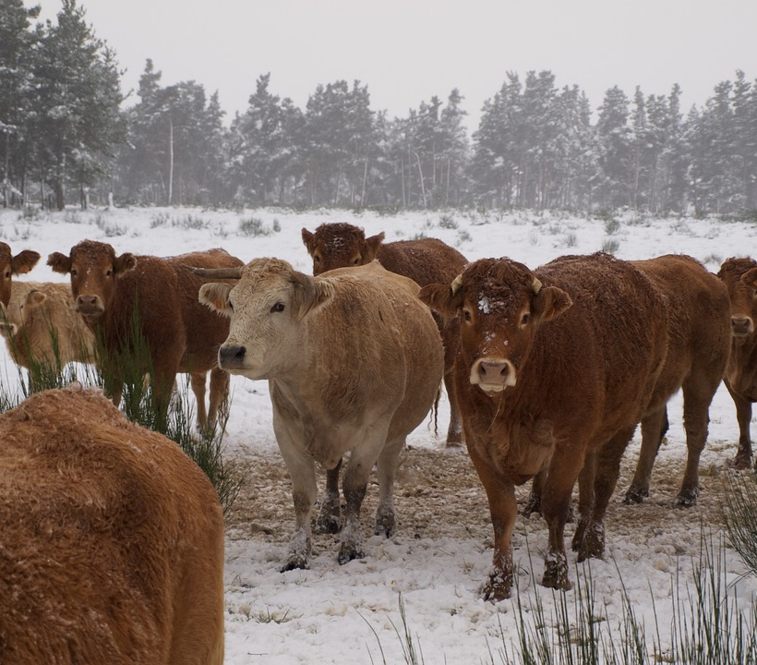
Project One Potential Factors Affecting California Beef Production
BETUL AKBAS
LORI BRADSHAW
CELESTEE WILLIAMS
ELIZABETH DWORKIN
PRIYADHARSINI DURAI ARASAN

Slide 2
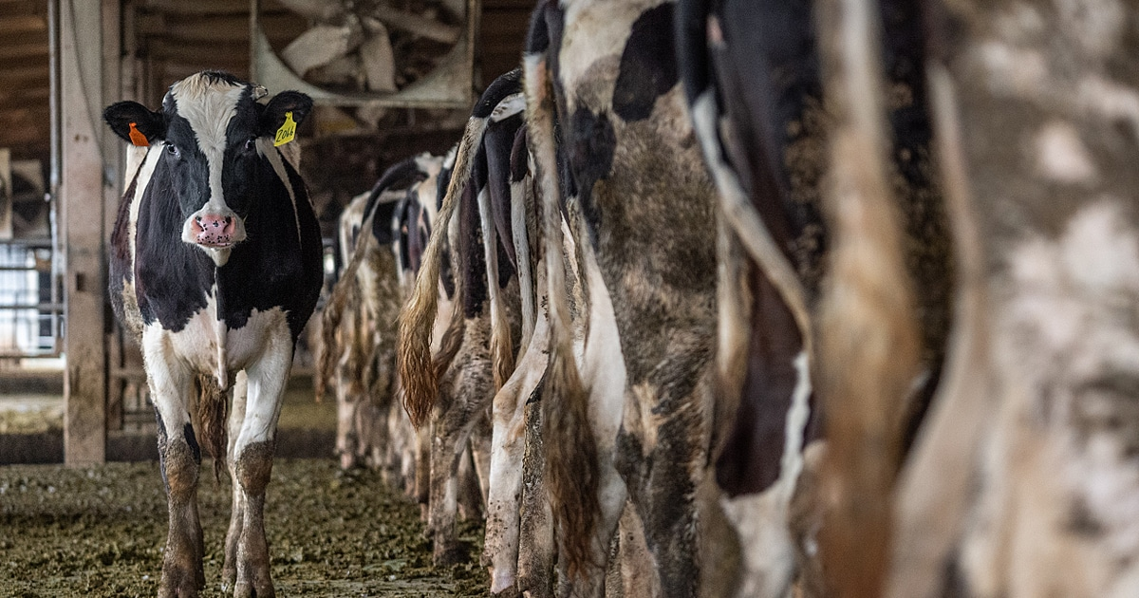
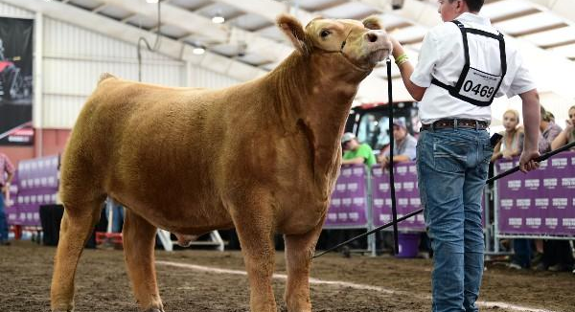
Executive Summary
Our topic began as an exploration of the effects of climate change. Because we have group members with experience in the industry, we chose to explore the subject by relating it to the cattle industry. We analyzed data on annual beef production compared to rainfall, temperature, and wheat production (as representative of food source for the cattle) in California over a period between 2000 and 2020.

Slide 3


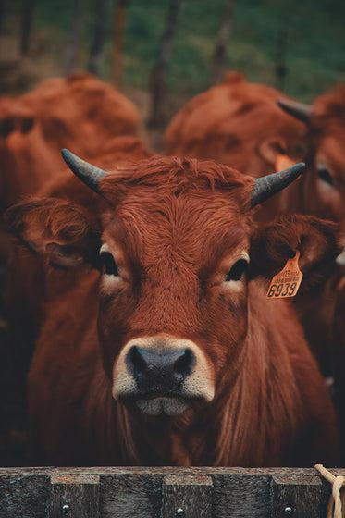
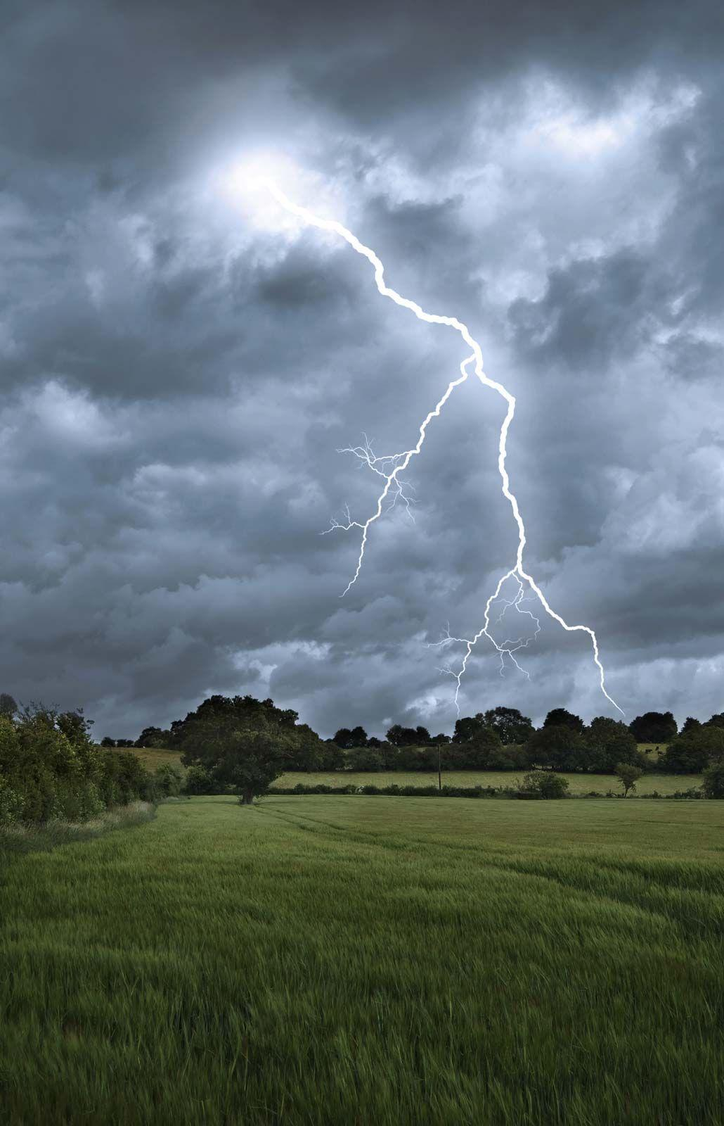
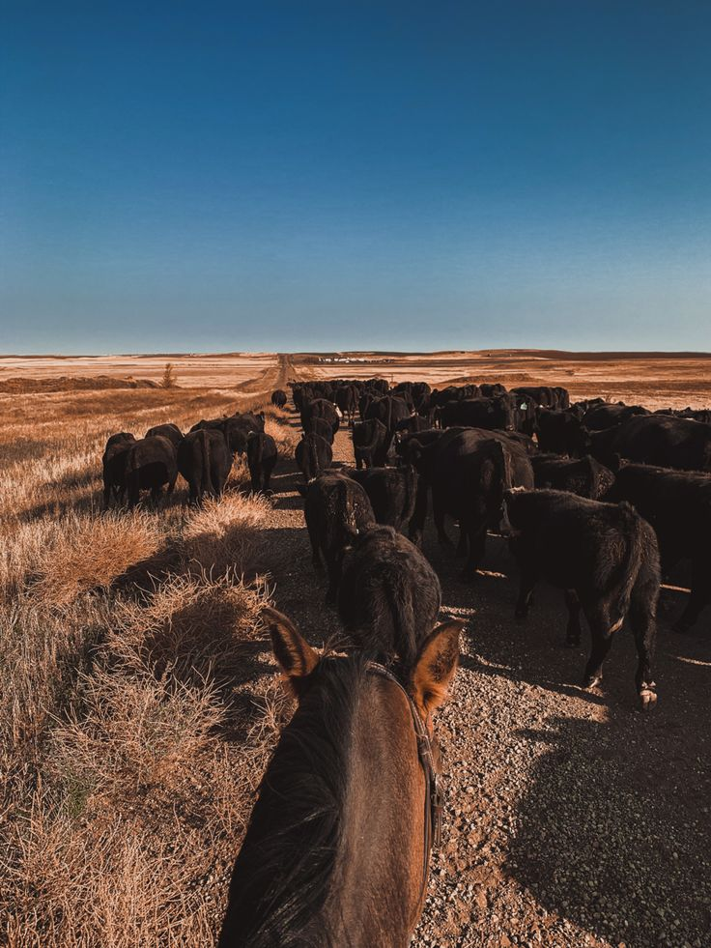

Data Source

Slide 4
Agenda
Key Questions
Per Question: Graphics
Per Question: Analysis
Summary Analysis

Slide 5
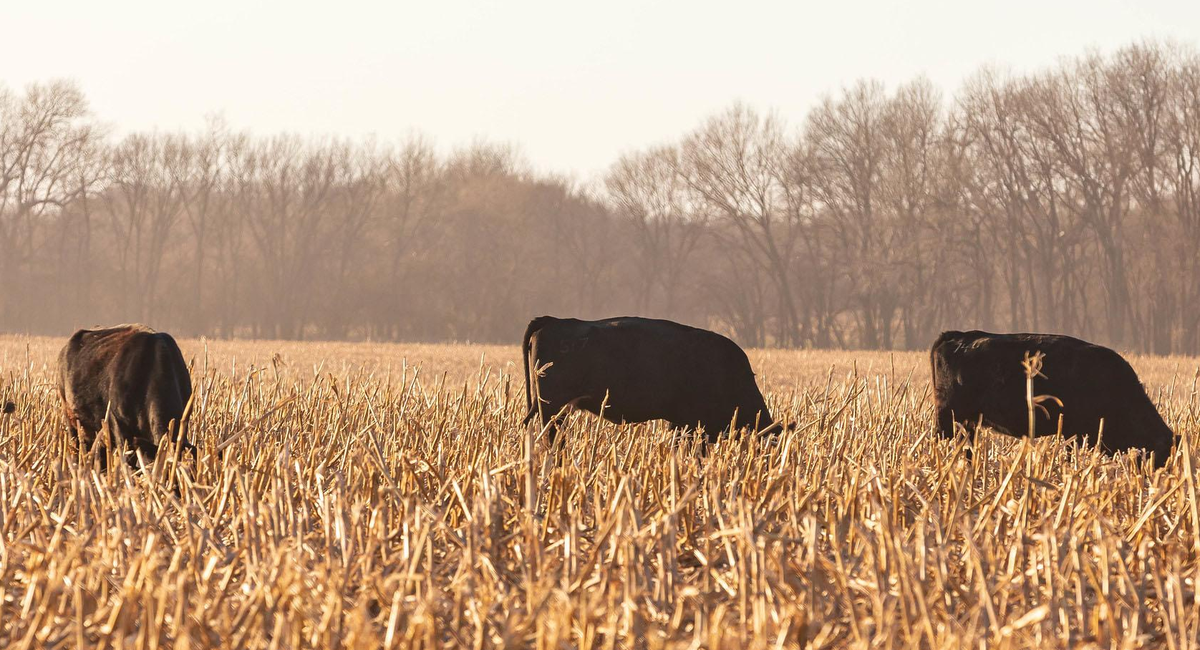
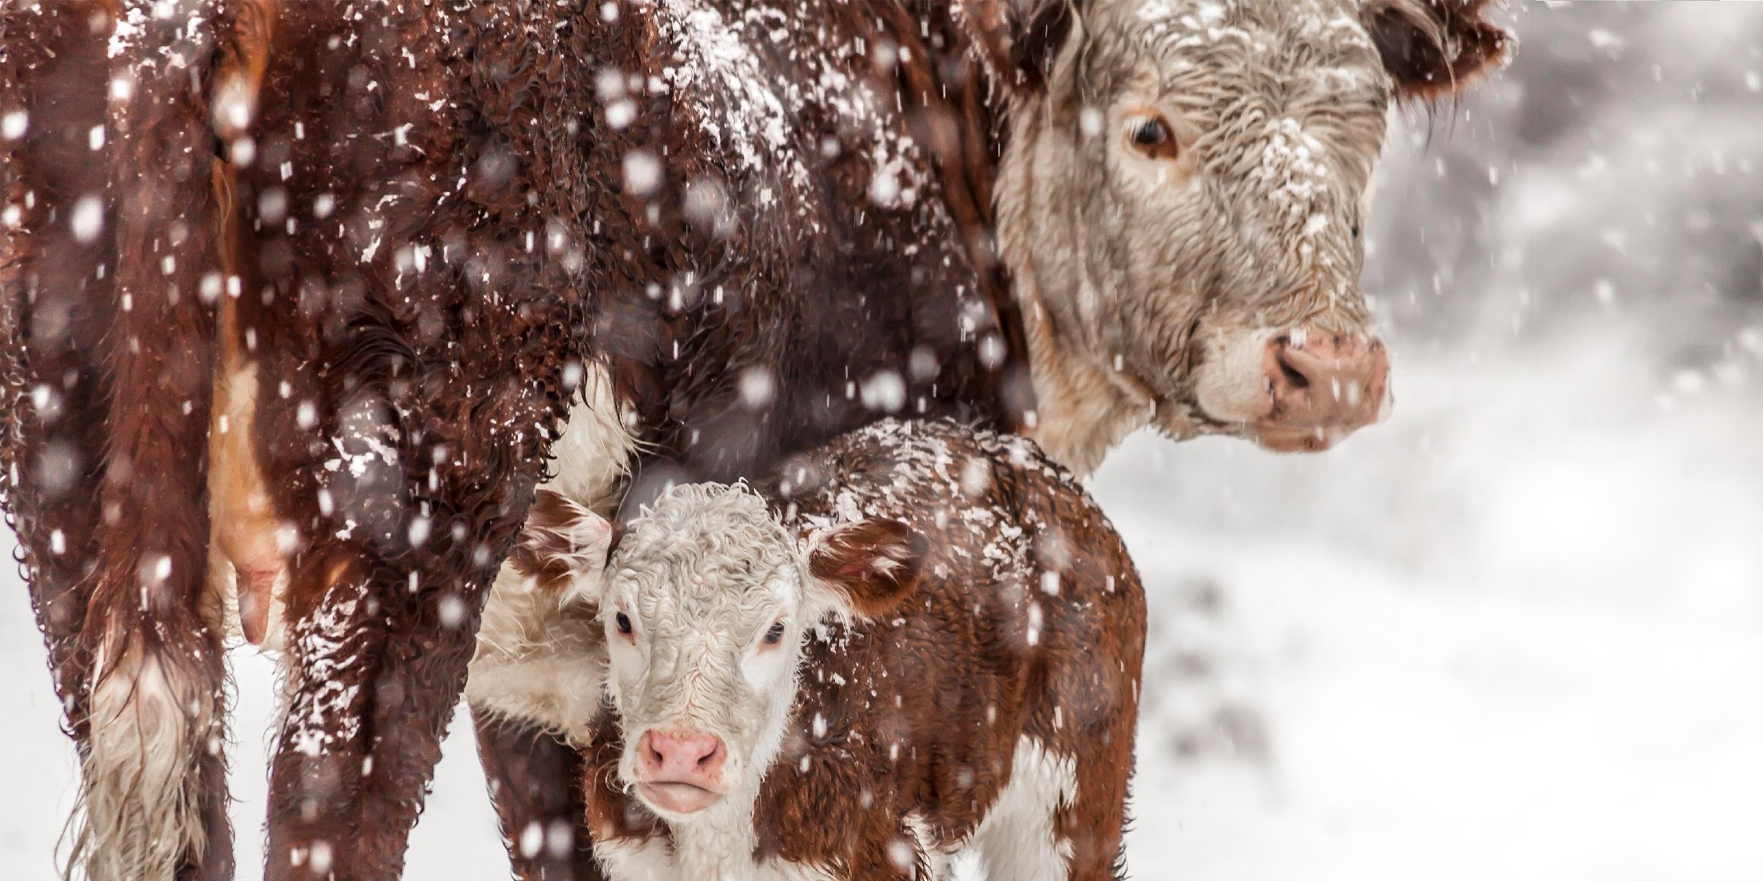
Components Influencing California's Beef Output
Which counties in California have the most beef cattle?
Does temperature impact beef production?
Does precipitation impact beef production?
Does california wheat production impact beef production in CA?
Notes:
Created by: Priya, Elizabeth, Lori

Slide 6
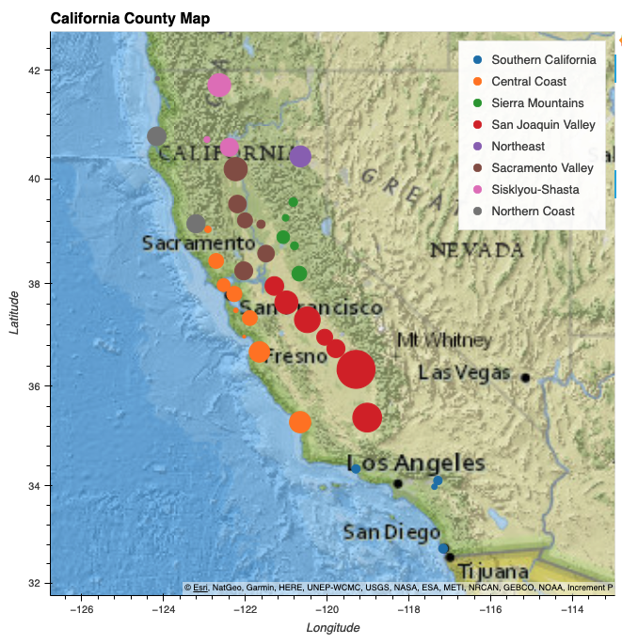
Visualization of Top Counties for Beef Production
Where in CA are beef cattle produced?
Notes:
*SHOULD BE CHRONOLOGICAL*

Slide 7
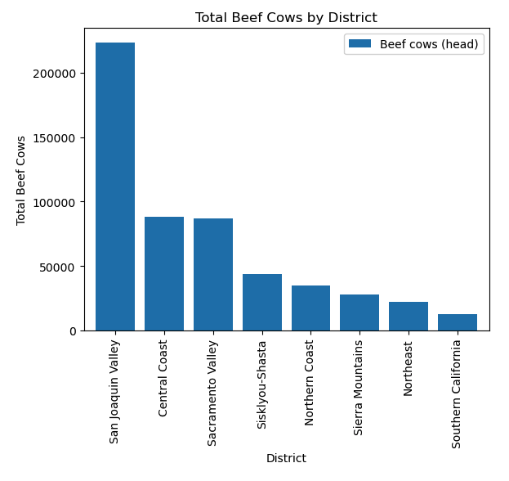
CA Regional Share of Beef Production
Where in CA are beef cattle produced?

Slide 8
How does the location of the cattle in California relate to potential effects of climate change?
Central portion of the state accounts for 75% of the cattle in the state
More temperate than northern and southern regions
Temperature extremes could reduce production due to stress on cattle
High and/or low temperatures would reduce growing season, affecting food availability
Large open areas for grazing and producing food
Increased rainfall creates flooding, risking livestock and food supply
Decreased rainfall causes droughts, reducing food supply

Slide 9
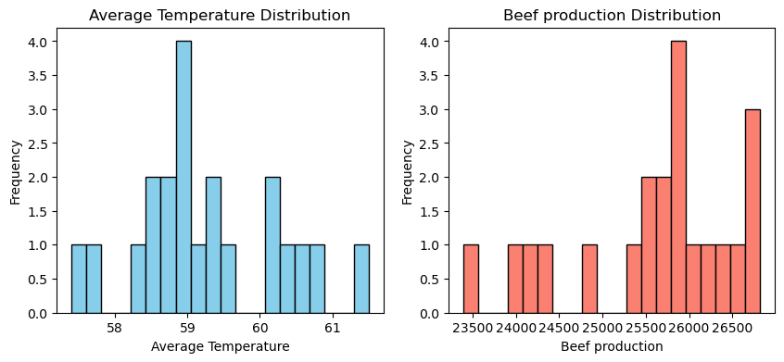
Temperature and Beef Production (2000-2020)
Does temperature impact beef production?
Notes:
yearly

Slide 10
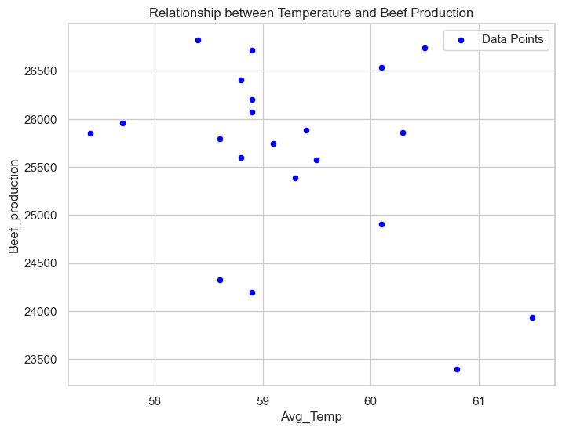
Scatter Plot with Linear Regression for Temperature and Beef Production
(2000 – 2020)
Does temperature impact beef production?
R squared value for the regression: 0.14
Slope of the regression line: -363.55
Intercept of the regression line: 47157.65
Negative linear correlation
Notes:
Yearly

Slide 11
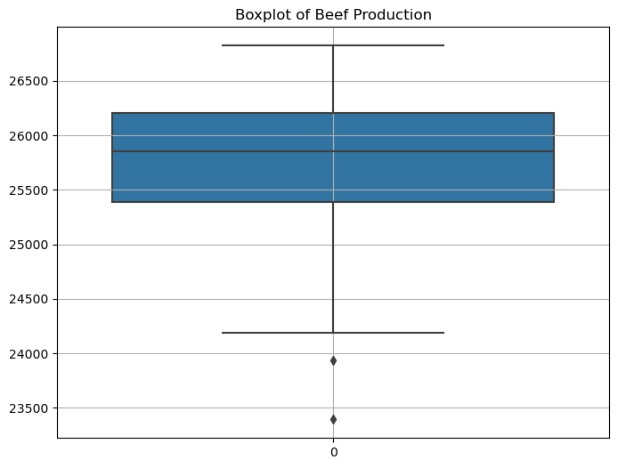
How do Average Monthly Temperature and Average Monthly Precipitation Impact Beef Production?

Slide 12
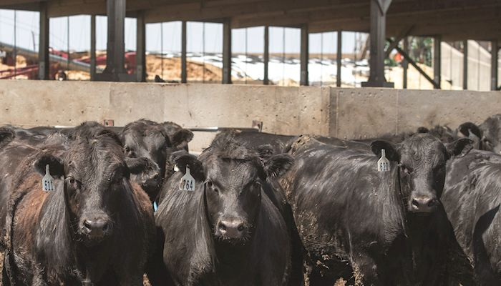
Does temperature impact beef production?
We chose to look at temperature as we thought it might have given us a broad view of the amount of plant material cattle would have to feed on. However, this data set was likely too broad in geography and too far away from direct cattle production. We found that temperature and beef production had a weak, negative relationship. Temperature in California has little to no direct impact on beef production within the state.

Slide 13
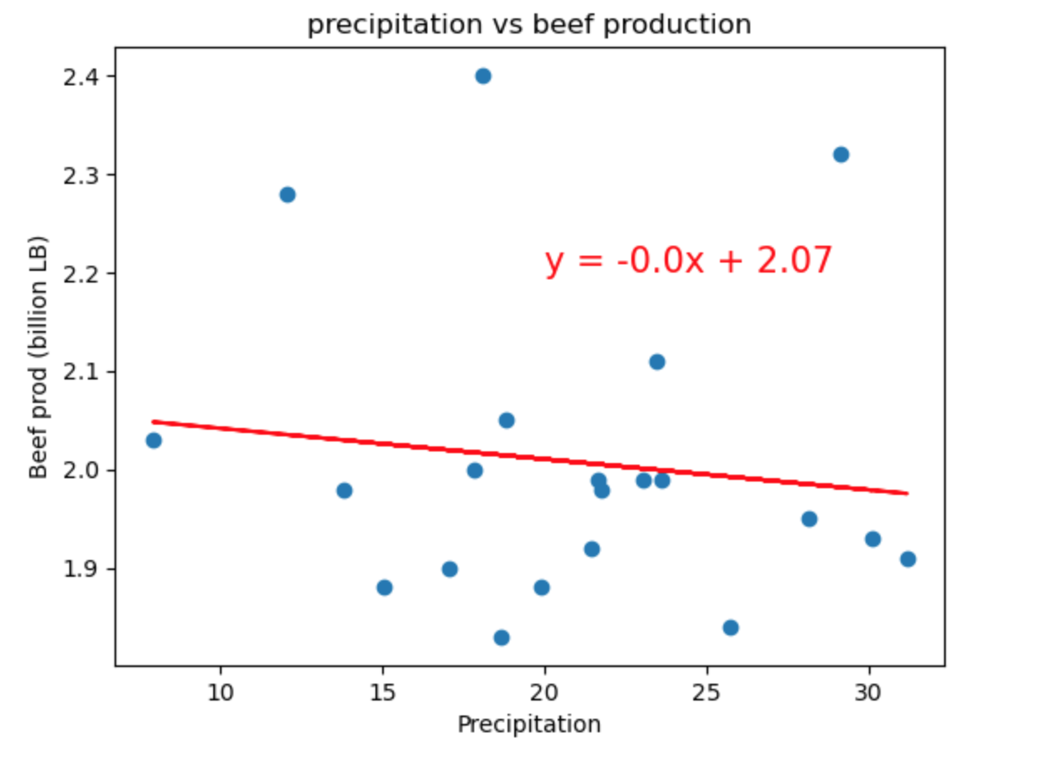
Does precipitation impact beef production?
Notes:
Scatter plot with line of best fit
*NEEDS A SIGNIFICANCE SCORE, x-axis should be average precipitation, y-axis should plot the meat production*

Slide 14
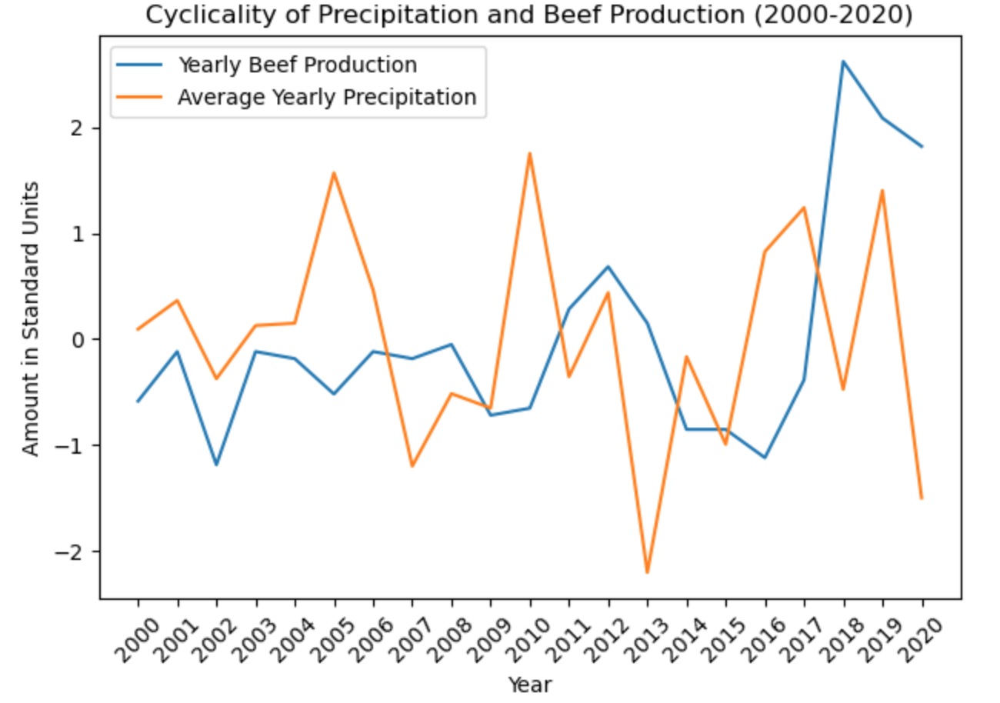
Does precipitation impact beef production?

Slide 15
Does precipitation impact beef production?
Precipitation is a primary source of water for both cattle consumption and irrigation of crops used as feed. Inadequate rainfall can lead to water scarcity, affecting both drinking water for cattle and the availability of water for irrigation.
When precipitation decreases, the beef yield is likely to decline and similarly when precipitation increases, beef production increases.
As the precipitation increases or decreases year by year, the response in beef production is seen slightly delayed as a result of productivity in crop.

Slide 16
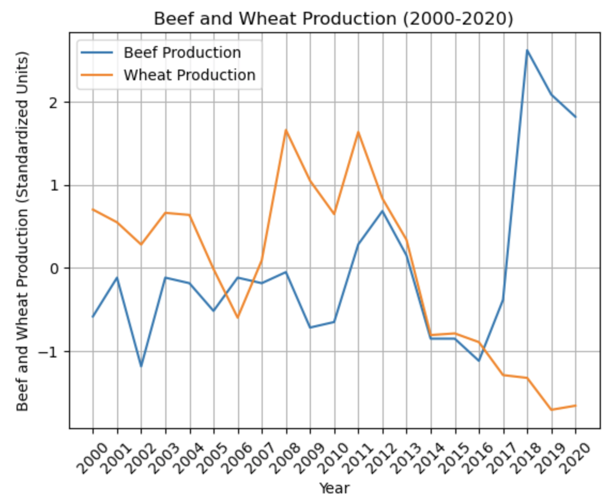
Beef and Wheat Production by Year (2000-2020)
Does wheat production impact beef production?
Notes:
*NEEDS A SIGNIFICANCE SCORE, x-axis should be average temp as expressed in +/- average, y-axis should plot the total cow products produced in $*

Slide 17
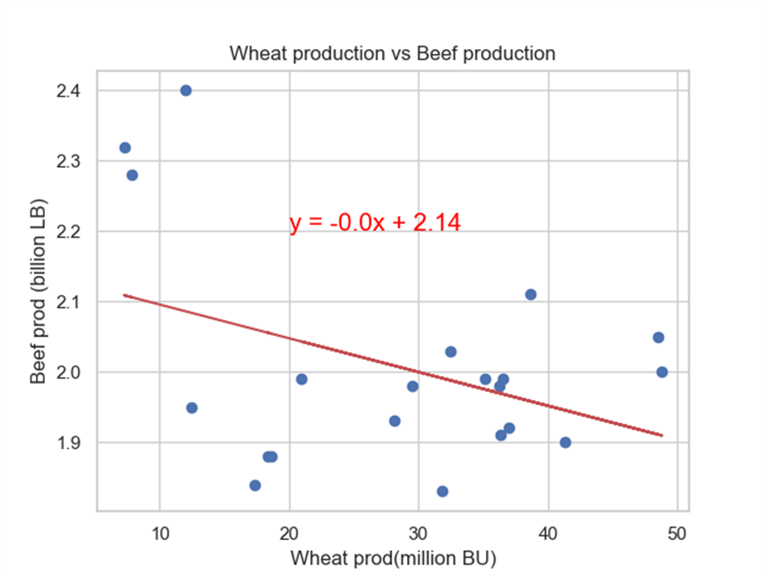
Wheat and Beef Production (2000-2020)
Correlation=-0.4
R Squared= .16
Negative Linear Correlation
Weak relationship

Slide 18
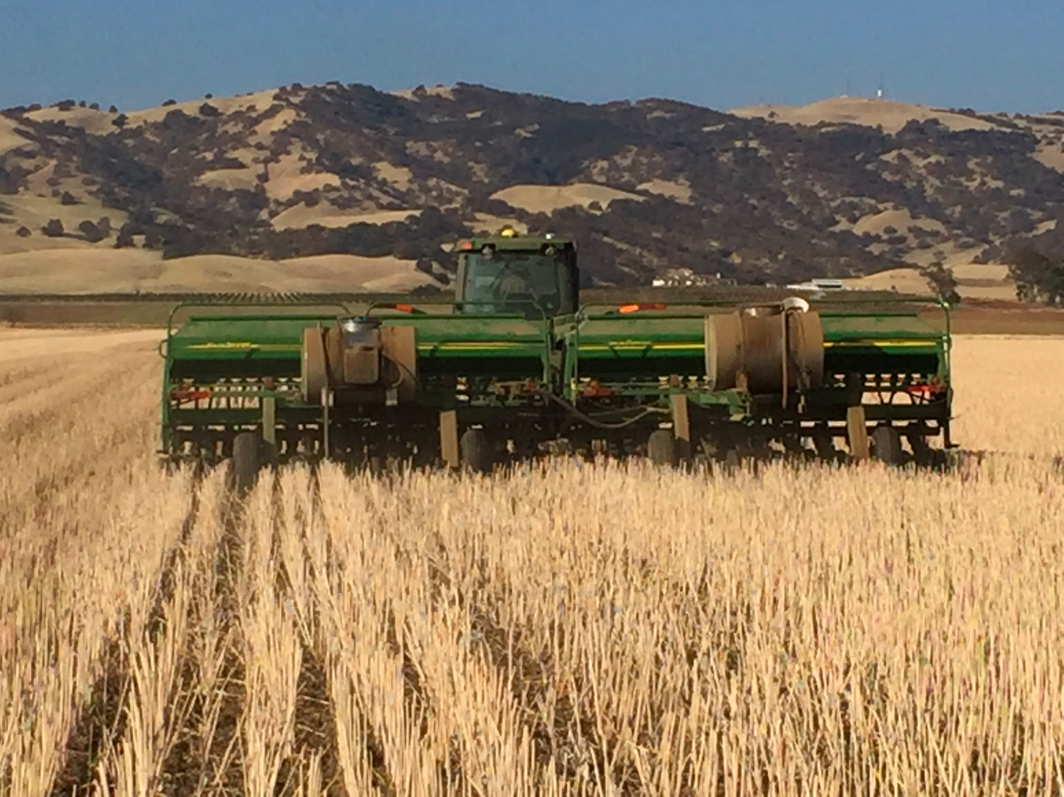
Does wheat production in CA affect beef production in CA?
Through our analysis of wheat and beef production in California, we determined that these two data sets demonstrate a weak, negative linear relationship. We have determined that wheat production within the state of California has little to no effect on beef production within the same geography.
Notes:
Analysis

Slide 19
Final Analysis
Beef production in California is spread throughout the state, though most beef cattle operations are in the San Joaquin Valley. Of the three potential factors in beef production we analyzed - precipitation, temperature, and wheat production - the strongest r score was for wheat and beef production. These two only demonstrated a weak, negative linear relationship. If we were to approach this problem again, we might instead have looked at a single county or region and looked exclusively at known feed sources.

Slide 20
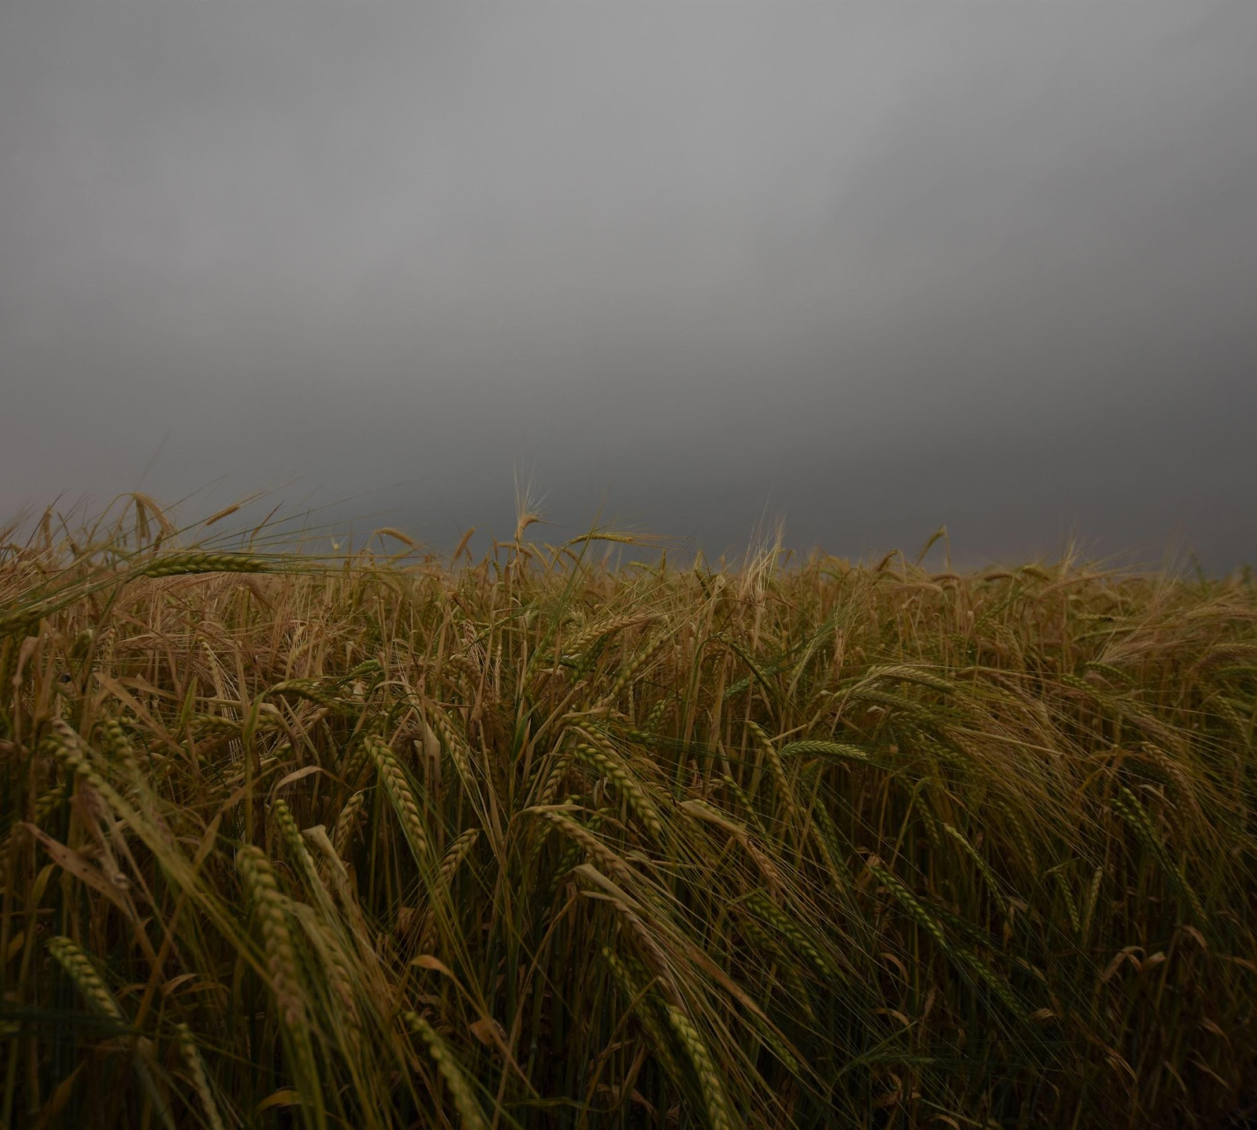
Thank you
PROJECT ONE, TEAM 5
AKBAS, BRADSHAW, DURAI ARASAN, DWORKIN, WILLIAMS
Presentation formatting and outline by Elizabeth Dworkin

